Slide 1
Border Gateway Routing Protocol (BGP)
BGP, or Border Gateway Protocol, is a standardized exterior gateway protocol used to exchange routing information between different autonomous systems (ASes) on the internet. It's fundamental to the operation of the internet, helping route data efficiently and reliably.
Purpose: BGP determines the best paths for data to travel across different networks. It helps in making decisions about the routing of data packets between different networks.
Autonomous Systems: An AS is a collection of IP networks and routers under the control of a single organization that presents a common routing policy to the internet. BGP is used to exchange routing information between these ASes.
Path Vector Protocol: BGP uses a path vector mechanism to maintain the path information that gets updated dynamically as the network topology changes.
Attributes: BGP routes are advertised with attributes that help in decision-making. These include AS path, next hop, local preference, and more.
Types of BGP: There are different types of BGP:
iBGP (Internal BGP): Used within a single AS to propagate routing information.
eBGP (External BGP): Used between different ASes.
Convergence: BGP is designed to handle large and complex routing tables and can take some time to converge, meaning it may take a bit to propagate routing updates and stabilize after network changes.
Security: BGP has some inherent security issues, such as the potential for route hijacking and prefix leaks. Various mechanisms like BGPsec and RPKI (Resource Public Key Infrastructure) have been developed to enhance its security.

Slide 2
Border Gateway Routing Protocol (BGP)
From the point of view of a BGP router, the world consists of ASes and the lines connecting them. Two ASes are considered connected if there is a line between a border router in each one.
Given BGP's special interest in transit traffic, networks are grouped into one of three categories. The first category is the stub networks, which have only one connection to the BGP graph. These cannot be used for transit traffic because there is no one on the other side.
Then come the multiconnected networks. These could be used for transit traffic, except that they refuse. Finally, there are the transit networks, such as backbones, which are willing to handle third-party packets, possibly with some restrictions, and usually for pay.
Pairs of BGP routers communicate with each other by establishing TCP connections. Operating this way provides reliable communication and hides all the details of the network being passed through.
BGP is fundamentally a distance vector protocol, but quite different from most others such as RIP. Instead of maintaining just the cost to each destination, each BGP router keeps track of the path used. Similarly, instead of periodically giving each neighbor its estimated cost to each possible destination, each BGP router tells its neighbors the exact path it is using.

Slide 3
Border Gateway Routing Protocol (BGP)
Consider the BGP routers shown in Figure. In particular, consider F's routing table. Suppose that it uses the path FGCD to get to D.
When the neighbors give it routing information, they provide their complete paths, as shown in Figure (for simplicity, only destination D is shown here).
After all the paths come in from the neighbors, F examines them to see which is the best. It quickly discards the paths from I and E, since these paths pass through F itself.
The choice is then between using B and G. Every BGP router contains a module that examines routes to a given destination and scores them, returning a number for the ''distance'' to that destination for each route.
Any route violating a policy constraint automatically gets a score of infinity. The router then adopts the route with the shortest distance. The scoring function is not part of the BGP protocol and can be any function the system managers want.

Slide 4
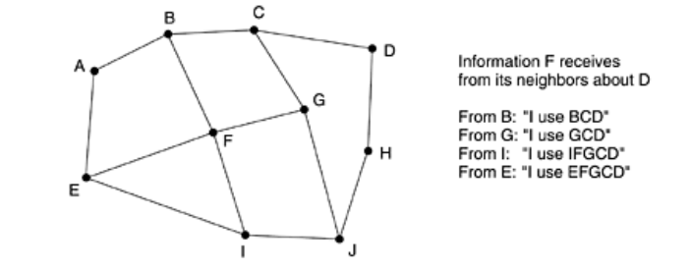
Border Gateway Routing Protocol (BGP)
BGP easily solves the count-to-infinity problem that plagues other distance vector routing algorithms. For example, suppose G crashes or the line FG goes down. F then receives routes from its three remaining neighbors. These routes are BCD, IFGCD, and EFGCD.
It can immediately see that the two latter routes are pointless, since they pass through F itself, so it chooses FBCD as its new route.
Other distance vector algorithms often make the wrong choice because they cannot tell which of their neighbors have independent routes to the destination and which do not.

Slide 5
Internet Protocol-IPv6
Internet Protocol version 6, is the most recent version of the Internet Protocol, designed to address the limitations of IPv4. It provides a vastly larger address space and includes several improvements to streamline internet communications.
Support billions of hosts, even with inefficient address space allocation.
Reduce the size of the routing tables.
Simplify the protocol, to allow routers to process packets faster.
Provide better security (authentication and privacy) than current IP.
Pay more attention to type of service, particularly for real-time data.
Aid multicasting by allowing scopes to be specified.
Make it possible for a host to roam without changing its address.
Allow the protocol to evolve in the future.
Permit the old and new protocols to coexist for year

Slide 6
Internet Protocol-IPv6
Key Features:
Larger Address Space:
IPv4: 32-bit address space, allowing for approximately 4.3 billion addresses.
IPv6: 128-bit address space, providing about 340 undecillion (3.4×10^38) addresses. This enormous space accommodates the growing number of devices and networks.
Simplified Header Format:
IPv6 headers are designed to be more efficient by streamlining and reducing the complexity of the header fields compared to IPv4.
Enhanced Security:
IPv6 was designed with security in mind. It supports IPsec (Internet Protocol Security) as a fundamental feature, providing better encryption and data integrity.
Improved Packet Processing:
IPv6 eliminates the need for Network Address Translation (NAT) by providing a sufficient number of addresses, which simplifies end-to-end communication.
Built-in Quality of Service (QoS):
IPv6 includes flow labels to improve the handling of packets and enable better Quality of Service for real-time applications like video streaming and voice over IP.

Slide 7
Internet Protocol-IPv6
Autoconfiguration:
Stateless Address Autoconfiguration (SLAAC): Allows devices to automatically configure themselves with an IPv6 address without needing a DHCP server.
DHCPv6: Also used for address configuration but can work alongside SLAAC for additional configuration needs.
No Broadcast:
IPv6 does not use broadcast communication. Instead, it uses multicast and anycast to achieve similar functionality, which helps reduce network congestion.
Address Types:
Unicast: Single sender to a single receiver.
Multicast: Single sender to multiple receivers.
Anycast: Single sender to the nearest receiver in a group.

Slide 8
Internet Protocol-IPv6
Transition from IPv4:
Dual Stack: Networks can run IPv4 and IPv6 simultaneously, allowing gradual transition and coexistence.
Tunneling: IPv6 packets can be encapsulated within IPv4 packets to traverse IPv4-only networks.
Translation: Techniques like NAT64 and DNS64 help facilitate communication between IPv4 and IPv6 networks.
Example Address Formats:
IPv4 Address: 192.168.1.1
IPv6 Address: 2001:0db8:85a3:0000:0000:8a2e:0370:7334

Slide 9
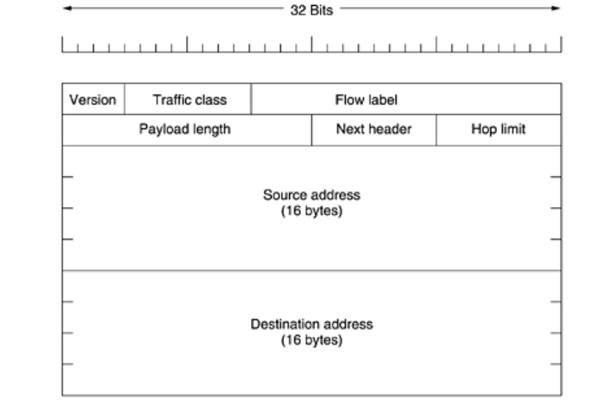
Internet Protocol-IPv6-Header Format

Slide 10
Internet Protocol-IPv6-Header Format
Version (4 bits):
Indicates the version of the IP protocol. For IPv6, this field is set to 6.
Traffic Class (8 bits):
Used to identify the class or priority of the packet, allowing for differentiated handling (similar to IPv4's Type of Service).
Flow Label (20 bits):
Provides a mechanism to label sequences of packets that require special handling, such as real-time data.
Payload Length (16 bits):
Specifies the length of the payload (the data part of the packet) in bytes, not including the header.
Next Header (8 bits):
Identifies the type of the next header immediately following the IPv6 header. It can be a higher-layer protocol (such as TCP or UDP) or an extension header.
Hop Limit (8 bits):
Functions similarly to the Time-to-Live (TTL) field in IPv4. It specifies the maximum number of hops (routers) a packet can pass through before being discarded.
Source Address (128 bits):
Contains the IPv6 address of the packet’s originator.
Destination Address (128 bits):
Contains the IPv6 address of the packet’s intended recipient.

Slide 11
Internet Protocol-IPv6-Header Format
A new notation has been devised for writing 16-byte addresses. They are written as eight groups of four hexadecimal digits with colons between the groups, like this:
8000:0000:0000:0000:0123:4567:89AB:CDEF
Since many addresses will have many zeros inside them, three optimizations have been authorized. First, leading zeros within a group can be omitted, so 0123 can be written as 123.
Second, one or more groups of 16 zero bits can be replaced by a pair of colons. Thus, the above address now becomes 8000::123:4567:89AB:CDEF
Finally, IPv4 addresses can be written as a pair of colons and an old dotted decimal number,
For example ::192.31.20.46.

Slide 12
Internet Protocol-IPv6-Header Format
IPv6 has introduced the concept of an (optional) extension header. These headers can be supplied to provide extra information, but encoded in an efficient way.
Six kinds of extension headers are defined at present, as listed in Figure. Each one is optional, but if more than one is present, they must appear directly after the fixed header, and preferably in the order listed.
Some of the headers have a fixed format; others contain a variable number of variable-length fields. For these, each item is encoded as a (Type, Length, Value) tuple.
The Type is a 1-byte field telling which option this is. The Type values have been chosen so that the first 2 bits tell routers that do not know how to process the option what to do.
The choices are: skip the option; discard the packet; discard the packet and send back an ICMP packet; and the same as the previous one, except do not send ICMP packets for multicast addresses.
The Length is also a 1-byte field. It tells how long the value is (0 to 255 bytes). The Value is any information required, up to 255 bytes.
The hop-by-hop header is used for information that all routers along the path must examine. so far, one option has been defined: support of datagrams exceeding 64K.

Slide 13
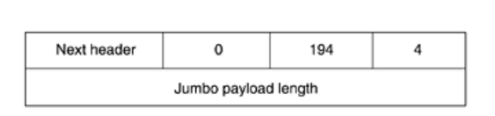
Internet Protocol-IPv6-Header Format
As with all extension headers, this one starts out with a byte telling what kind of header comes next. This byte is followed by one telling how long the hop-by-hop header is in bytes, excluding the first 8 bytes, which are mandatory.
The next 2 bytes indicate that this option defines the datagram size (code 194) and that the size is a 4-byte number. The last 4 bytes give the size of the datagram. Sizes less than 65,536 bytes are not permitted and will result in the first router discarding the packet and sending back an ICMP error message.
Datagrams using this header extension are called jumbograms. The use of jumbograms is important for supercomputer applications that must transfer gigabytes of data efficiently across the Internet.
The destination options header is intended for fields that need only be interpreted at the destination host. In the initial version of IPv6, the only options defined are null options for padding this header out to a multiple of 8 bytes, so initially it will not be used.

Slide 14
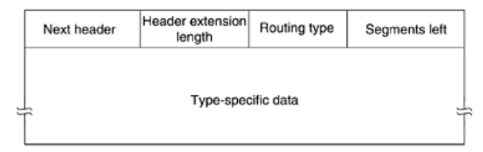
Internet Protocol-IPv6-Header Format
The routing header lists one or more routers that must be visited on the way to the destination. It is very similar to the IPv4 loose source routing in that all addresses listed must be visited in order, but other routers not listed may be visited in between. The format of the routing header is shown in Figure.
The first 4 bytes of the routing extension header contain four 1-byte integers. The Next header and Header extension length fields were described.
The Routing type field gives the format of the rest of the header. Type 0 says that a reserved 32-bit word follows the first word, followed by some number of IPv6 addresses.
Finally, the Segments left field keeps track of how many of the addresses in the list have not yet been visited. It is decremented every time one is visited. When it hits 0, the packet is on its own with no more guidance about what route to follow. Usually at this point it is so close to the destination that the best route is obvious.

Slide 15
Internet Protocol-IPv6-Header Format
The fragment header deals with fragmentation similarly to the way IPv4 does. The header holds the datagram identifier, fragment number, and a bit telling whether more fragments will follow.
In IPv6, unlike in IPv4, only the source host can fragment a packet. Routers along the way may not do this. Although this change is a major philosophical break with the past, it simplifies the routers' work and makes routing go faster.
If a router is confronted with a packet that is too big, it discards the packet and sends an ICMP packet back to the source. This information allows the source host to fragment the packet into smaller pieces using this header and try again.
The authentication header provides a mechanism by which the receiver of a packet can be sure of who sent it.
The encrypted security payload makes it possible to encrypt the contents of a packet so that only the intended recipient can read it. These headers use cryptographic techniques to accomplish their missions.

